Slide 1


HIDAYAT ULLAH
B24F0050AI099

Slide 2
Artificial intelligence
INTRUDUCTION
TECHNIQUES
APPLICATION
TOOLS AND TECHNIQUES

Slide 3
INTRODUCTION
Artificial intelligence is the ability to create thinking in a machine
Artificial Intelligence (AI) is a technology that enables machines to mimic human intelligence
(AI) is a field of technology that enables machines to perform tasks requiring human-like intelligence, such as learning

Slide 4
TECHNIQUES
Machine Learning (ML):
Natural Language Processing (NLP):
Computer Vision:
Expert Systems:

Slide 5
APPLICATION
Healthcare: AI assists in diagnosing diseases, personalizing treatments, and analyzing medical imaging for faster and more accurate results.
Finance: Used for fraud detection, credit scoring, algorithmic trading, and personalized financial advice.
Retail: Powers recommendation engines, inventory management, and customer service through chatbots and personalized marketing.

Slide 6
Retail: Powers recommendation engines, inventory management, and customer service through chatbots and personalized marketing.
Transportation: Enables self-driving vehicles, optimizes traffic management, and enhances route planning and logistics.
Agriculture: AI-driven tools support crop monitoring, soil health analysis, and predictive yield modeling for improved farming efficiency

Slide 7
Tools:
TensorFlow: An open-source framework by Google for building and training machine learning and deep learning models.
PyTorch: A flexible, open-source machine learning library by Facebook, popular for deep learning research and applications.

Slide 8
Scikit-Learn: A Python library offering simple, efficient tools for data mining and machine learning tasks.
IBM Watson: A suite of AI tools for natural language processing, machine learning, and computer vision, tailored for enterprise use.
Azure Machine Learning: A cloud-based platform from Microsoft to develop, train, and deploy AI models.

Slide 9
Techniques
Supervised Learning: Training models on labeled data to make predictions or classify data.
Unsupervised Learning: Using unlabeled data to find patterns or groupings, such as clustering and association.

Slide 10
Reinforcement Learning: Teaching models to make a series of decisions to maximize cumulative reward in a given environment.
Deep Learning: Employs neural networks with multiple layers to handle complex tasks, such as image and speech recognition.
Transfer Learning: Reusing a pre-trained model on a new but similar task, accelerating training and improving performance with less data.

Slide 11
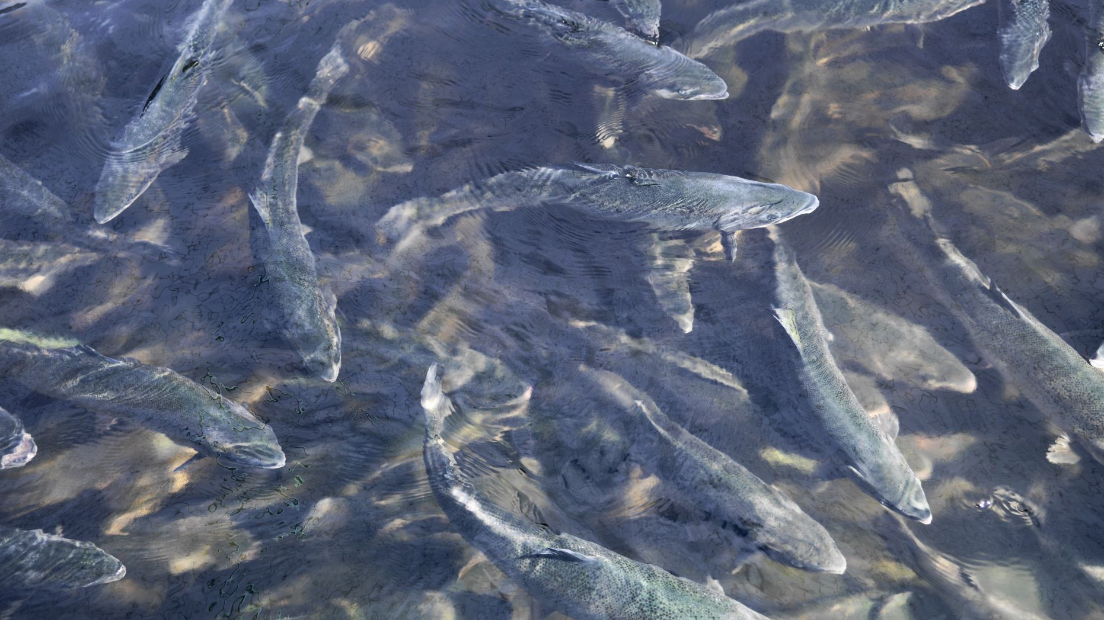
Thank you so mach

